Slide 1

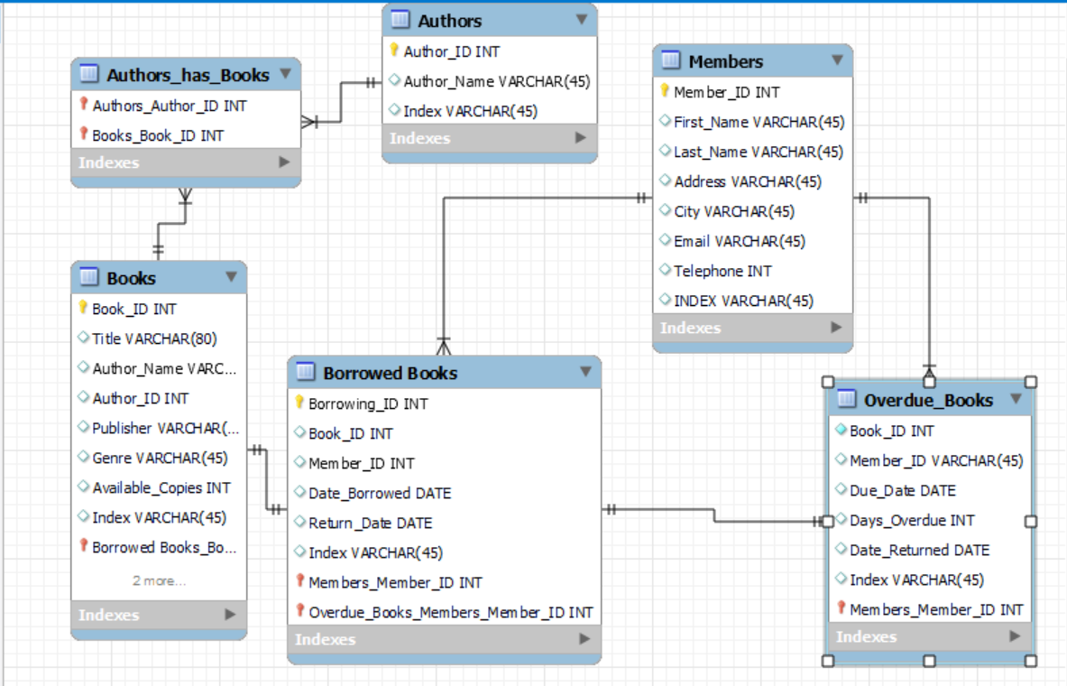
Local Library Database
Alice Rais

Slide 2
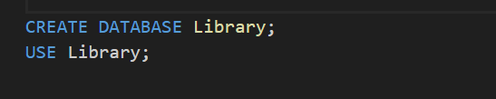
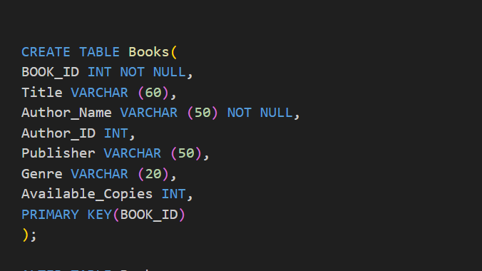

Slide 3




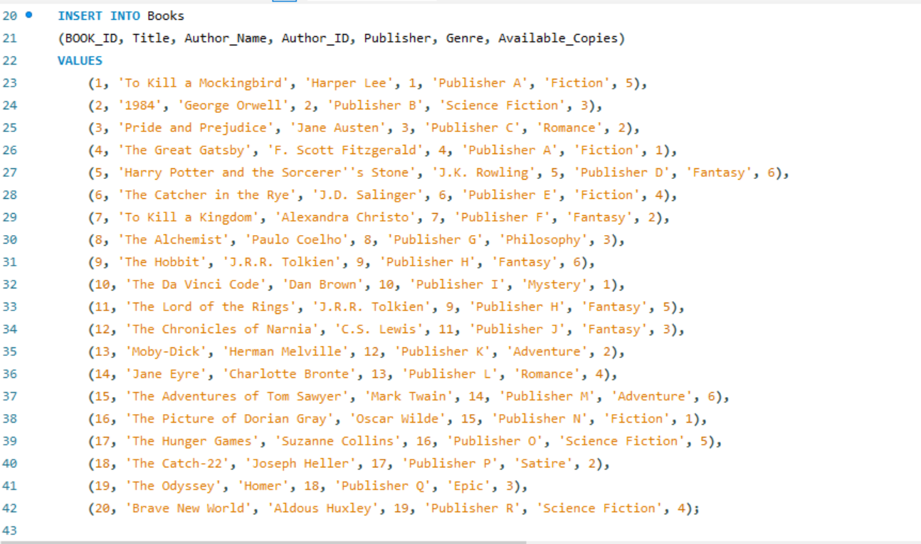

Slide 4


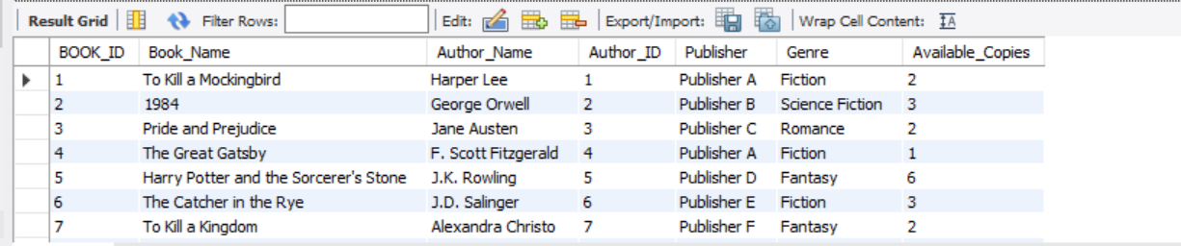
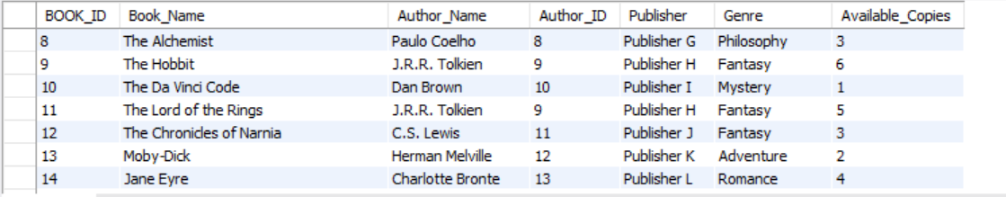
Subtitle

Slide 5
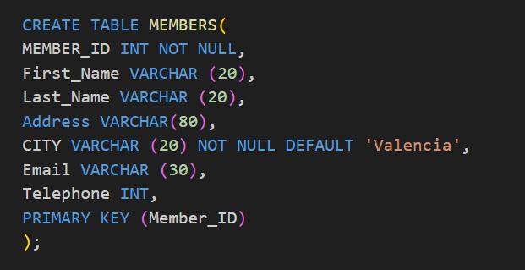
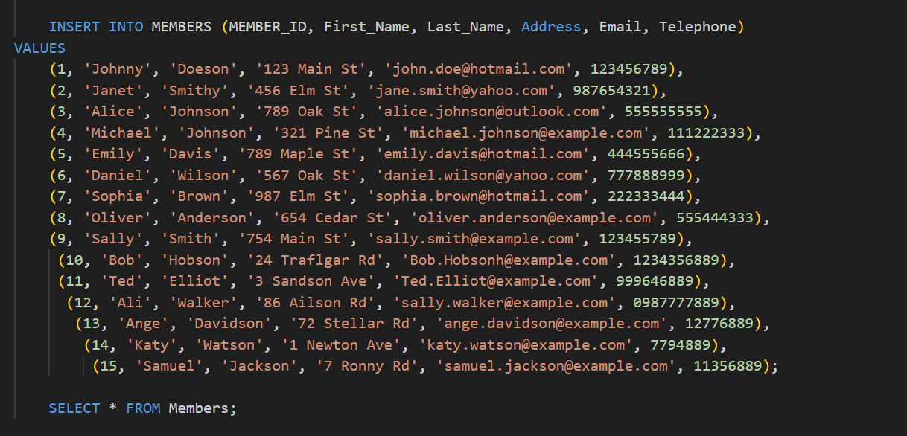
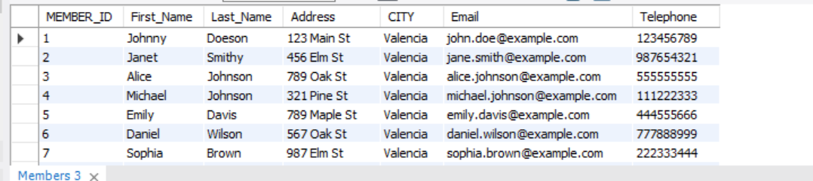
Chart

Slide 6
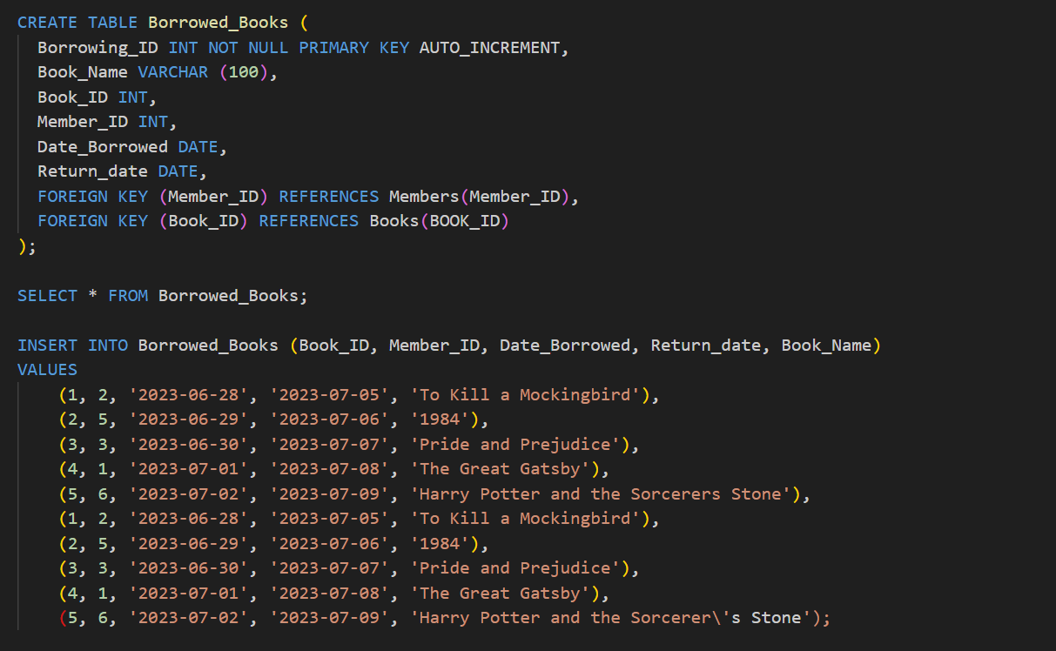
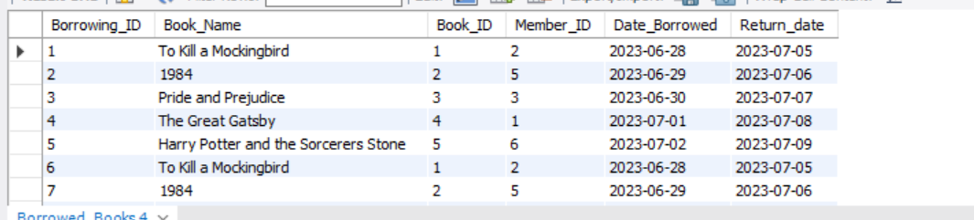

Slide 7
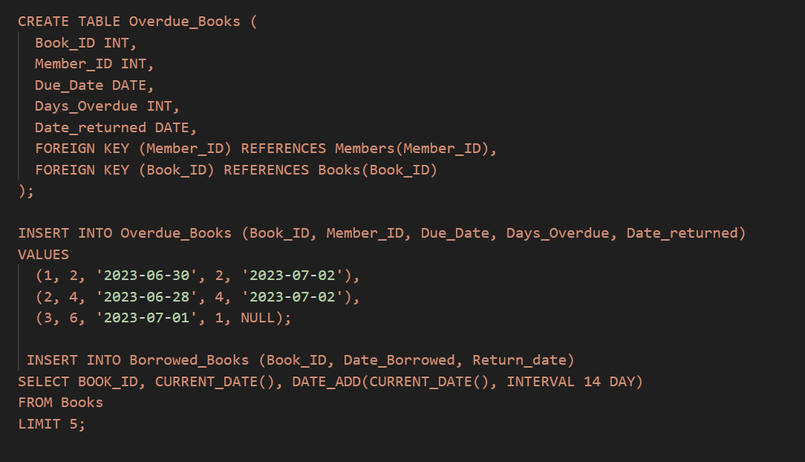
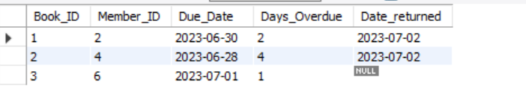

Slide 8
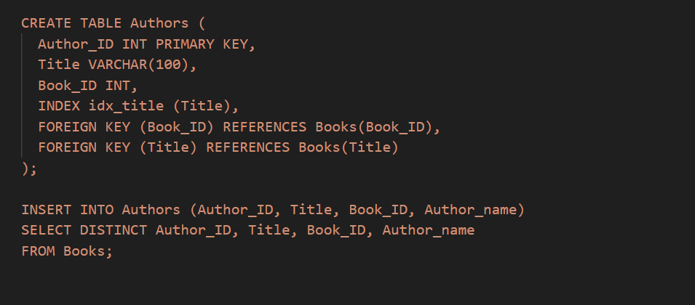
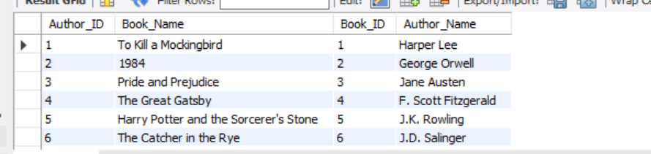

Slide 9
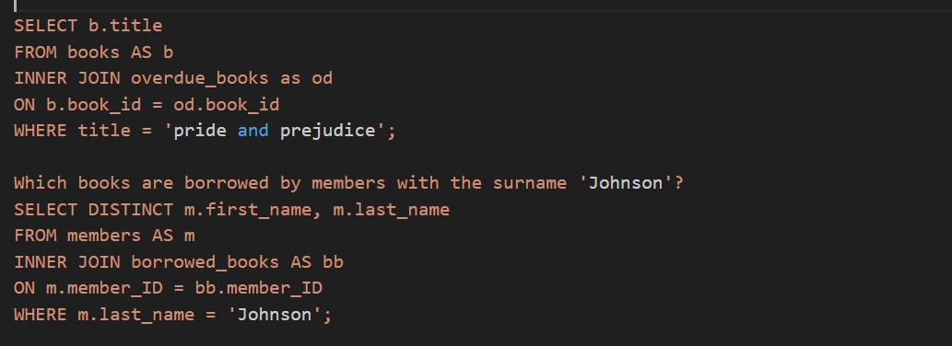
Using any type of the joins create a view that combines multiple tables in a logical way

Slide 10
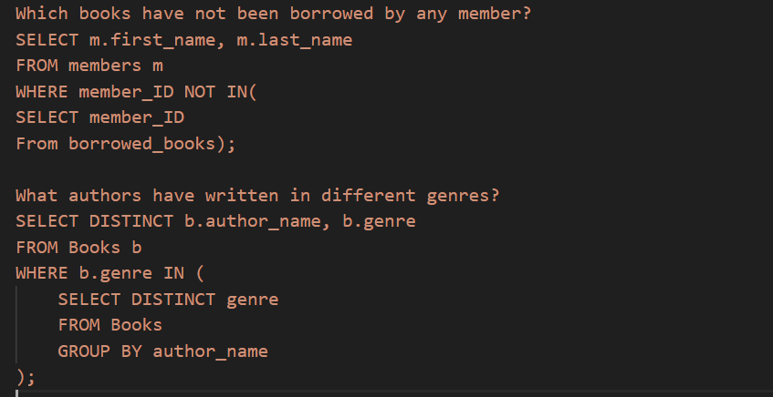
Prepare an example query with a subquery to demonstrate how to extract data from your DB for analysis

Slide 11
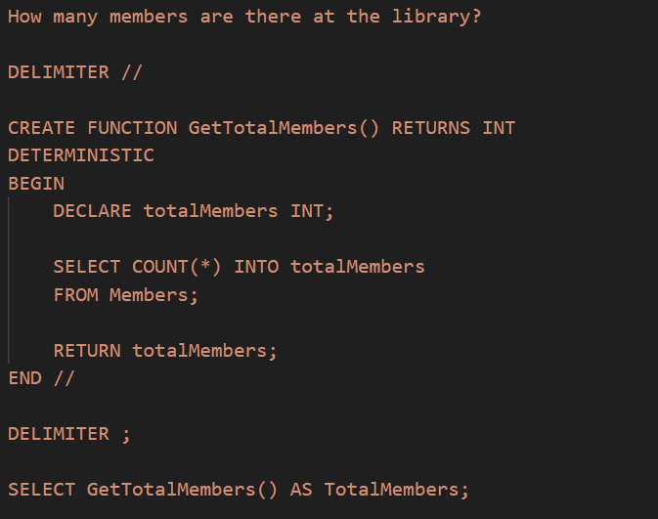
In your database, create a stored function that can be applied to a query in your DB

Slide 12
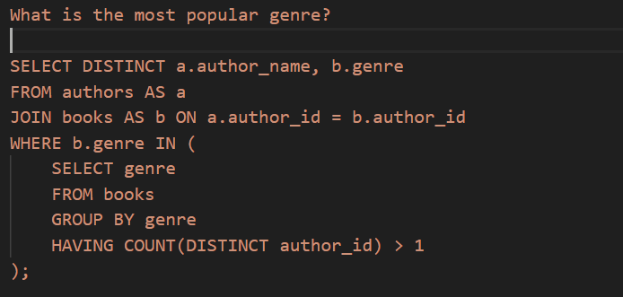
Prepare an example query with group by and having to demonstrate how to extract data from your DB for analysis

Slide 13
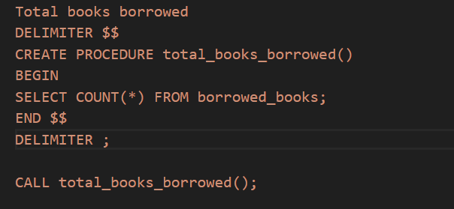
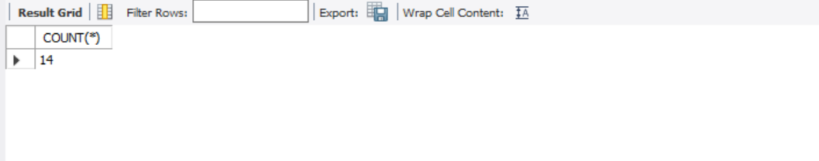
Create a store procedure and show how it runs

Slide 14
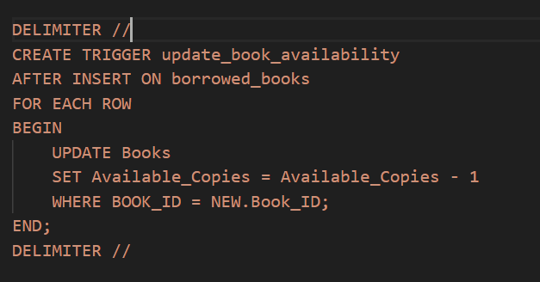
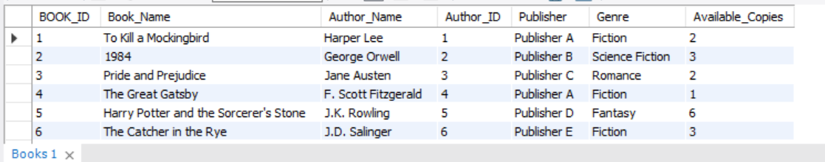

In your database, create a trigger and demonstrate how it runs This trigger will update the book availability status in the 'Books' table after an insertion is made into the 'borrowed_books' table.

Slide 15
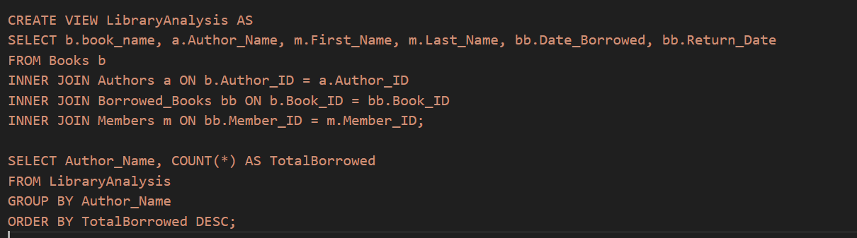
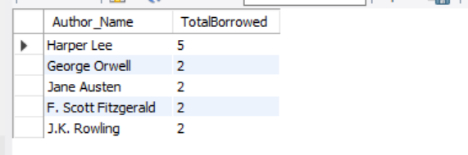
Create a view that uses at least 3-4 base tables, produce a logically arranged result set for analysis. Calculate the total number of books borrowed for each author in descending order to see which authors have the most books borrowed and are therefore the most popular authors.

Slide 16


Thank You
Alice Rais

